Slide 1
About Procedures (A how-to guide for writing how-to guides)
(Adapted from: http://classes.engr.oregonstate.edu/mime/winter2011/ie366-001/Other_Resources/WE3M-Writing-Procedures.pdf)

Slide 2
Discussion Topics
Procedure Pitfalls
Process Description Vs Set of Procedures
4 Tips for Good Procedural Writing
The Importance of Parallelism
Rules for Sequencing
Criteria for Good Procedural Writing

Slide 3
Procedure Pitfalls
Consider these two instructions:
“Press F12. Unless you don’t want to delete everything you have entered.”
“Determine the number of hours of sick leave which may be credited to an employee, other than a part-time employee, by multiplying the total months of service of the subject employee by four and subtracting three from the sum total of the number of hours of sick leave previously taken by the subject employee.”

Slide 4
Process Description Vs Set of Procedures
A Process Description is presented in narrative form:
Entering Multiple Addresses
With this application, the user can submit up to 20 addresses. The software geocodes as many addresses as it can and then identifies any addresses that can’t be geocoded. The user can print a list of the addresses that weren’t geocoded, print a form that describes each address’s situation, identify addresses for researching, or print a report on the addresses.

Slide 5
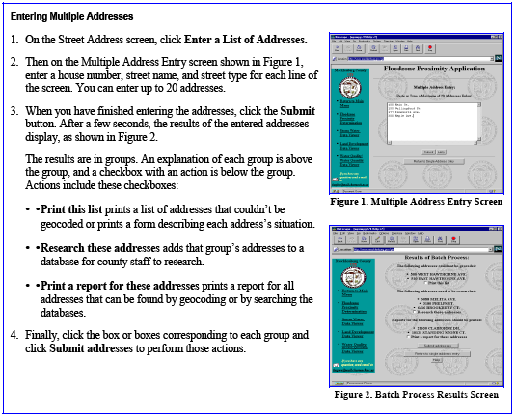
Process Description Vs Set of Procedures
A set of procedures is presented in bullets and illustrations:

Slide 6
Process Description Vs Set of Procedures
Process Description | Procedural Writing
Tells “what.” Documents what someone did (or will do). Assumes the reader may not be the person to carry out the process. Uses the indicative verb form (the technician measured the… OR we measured the…). Uses regular paragraph structure. | Tells “how.” Tells exactly how to get from point A to point B Assumes the reader will be the person to carry out the process. Uses the imperative verb form (Measure the… ) Uses bulleted or numbered lists.

Slide 7
4 Tips for Good Procedural Writing
Use correct sequencing (more on this later).
Break long procedures into shorter modules based on audience needs.
Use recognizable warning signs as needed:
DANGER • WARNING • Caution • Note
Avoid “you should” or “you might.”

Slide 8
The Importance of Parallelism
Parallelism/parallel structure: using the same types of words (such as imperative verbs) or the same grammatical structure to emphasize similar items.
All items in a given list should be either fragments OR complete sentences.

Slide 9
Rules for Sequencing
Number every step (but use bullets or letters for options or components within a step).
Avoid “do-this-if-you-want-to-do-that.” Instead, use this structure: “To do this, do that.”
Avoid “do-this after-you-do-that.” Instead, use this structure: “First do this, and then do that.”
Use one action per step, unless they are related:
Type your name in the box and click Submit.
Use transitions to build connections between steps.

Slide 10
Criteria for Good Procedural Writing
Is the format comfortable to use and appropriate to the audience, the type of use, and the topic?
Is the overall document well organized?
Is it divided into logical sections or chapters?
Is each section or chapter organized with logical, parallel, consistent headings?
Is there an apparent hierarchy in the headings and subheadings?
Do the headings and subheadings follow a pattern?
Is the text supported by effective navigational aids, like a table of contents, an index, tabs?
Is the text organized into paragraphs or steps?
Are bulleted or numbered lists used effectively?
Is the writing clear and accurate?
Does the writing use parallel construction?
Is the level of detail appropriate to the task and the audience?
Is it written in active, imperative sentences?
Does the text use effective transitions?
Does it use consistent terminology (a menu is always a menu, never a screen or a selection list)?
Is the vocabulary appropriate to the task and the audience?
Does the document show and tell, and not just tell?
Is the text supported by visual aids, like screen shots, icons, workflow diagrams, and tables?
Is it supported by notes, cautions, and warnings that are used and displayed effectively?
Bottom line—is the document usable? If your job—or your life—depended on the success of the procedure, could you do it?

